Slide 1
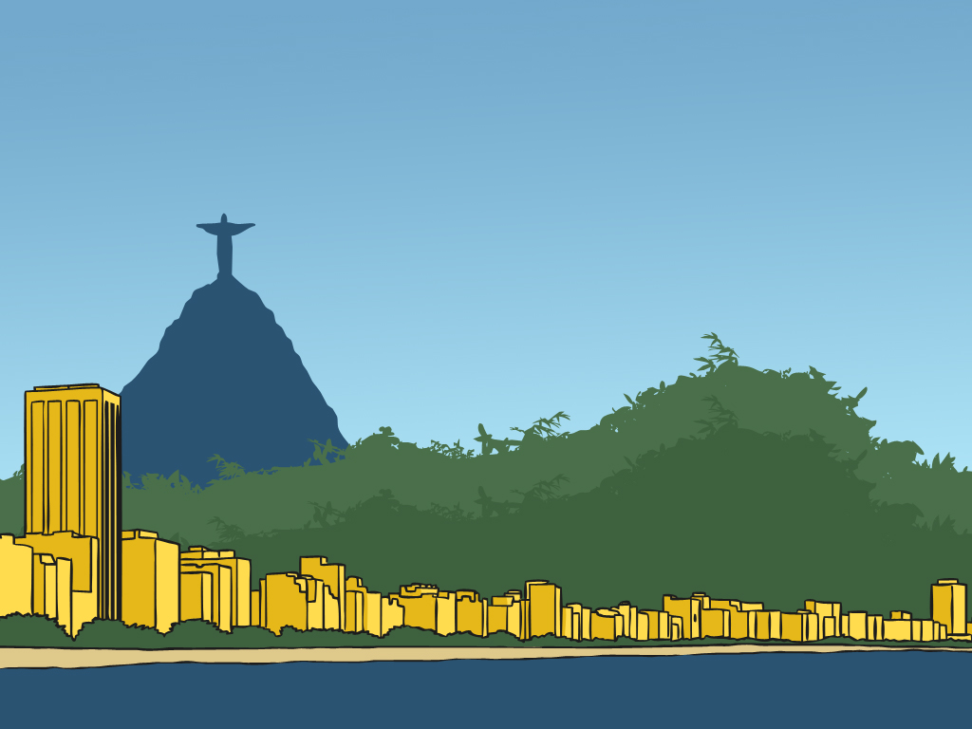

Rio de Janeiro

Slide 2
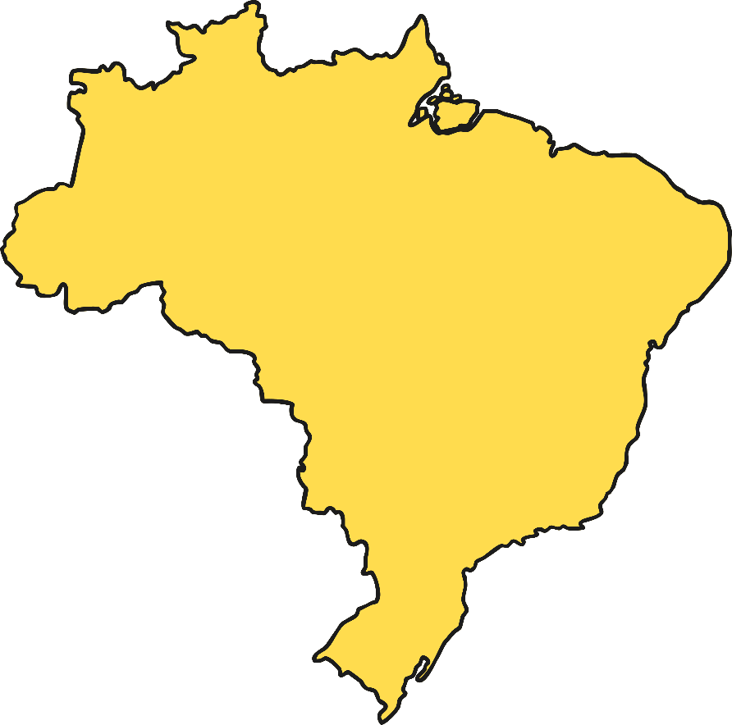
Rio de Janeiro
Brazil
Rio de Janeiro

Slide 3
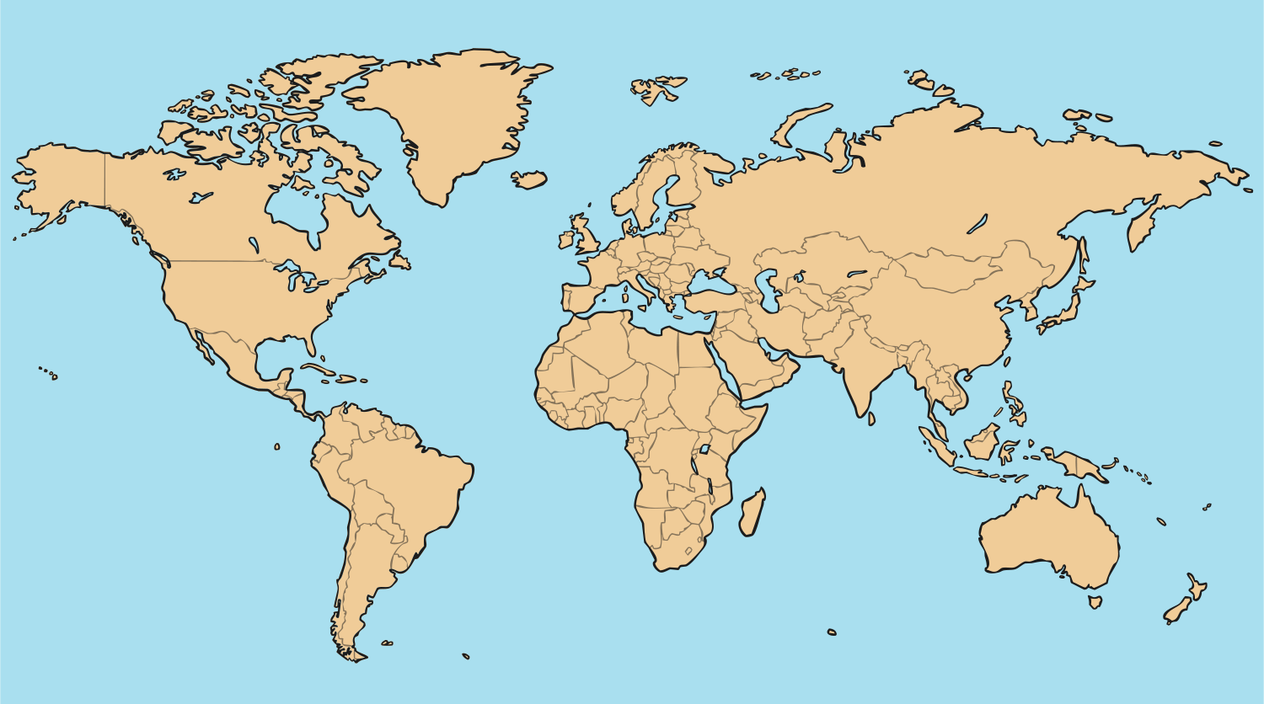
Where is Rio de Janeiro?
Rio de Janeiro is the second largest city in the country called Brazil. Brazil can be found in the continent of South America.
North America
Asia
Rio de Janeiro
Australia/Oceania
Brazil
South America
Africa

Slide 4
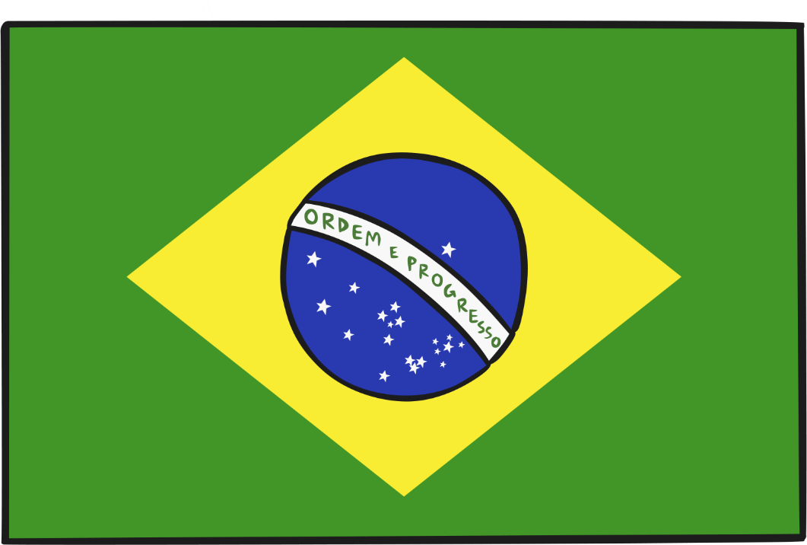
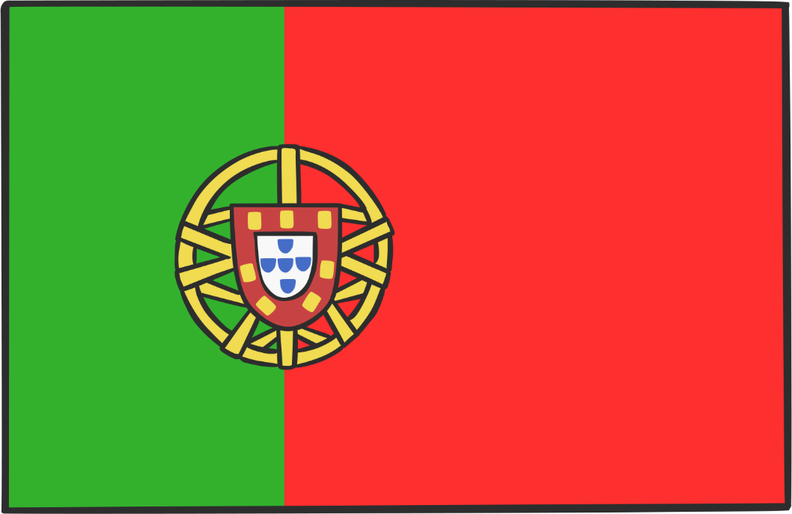
History
Rio de Janeiro was first discovered by the Portuguese on 22nd April 1500.

Slide 5
Landmarks of Rio de Janeiro

Slide 6
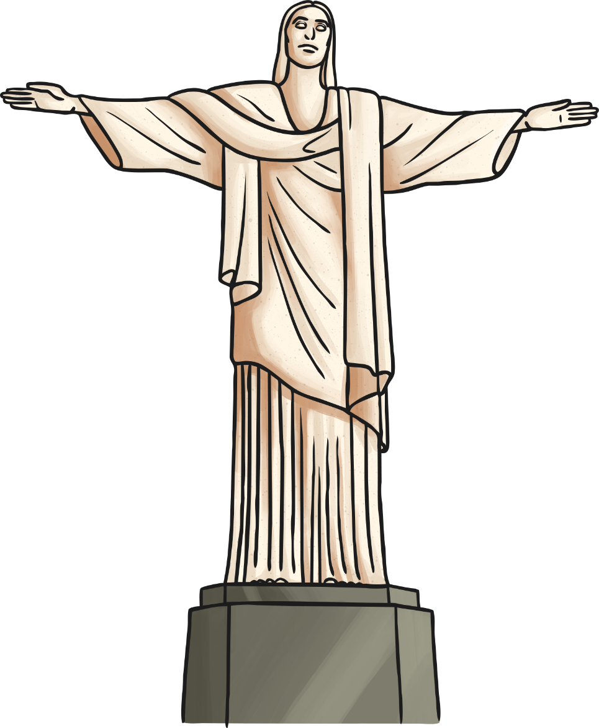
Christ the Redeemer Statue in Tijuca Forest
The statue of Christ the Redeemer is a religious statue which can be found on the top of Corcovodo Mountain. It is a 30 metre tall statue of Jesus Christ with his arms stretched out embracing the city and has been there since 1931.

Slide 7

Sugarloaf Mountain in
Guanabara Bay
Sugarloaf Mountain is one of the world’s most famous natural landmarks. The name comes from the mountain’s resemblance to a sugarloaf. The top can be reached by cable cars and an amazing view across the city and bay can be seen from there.

Slide 8

Copacabana Beach
Located in Zona Sul, Copacabana Beach is one of the most famous and most beautiful beaches in the world. It is 4km long.
Photo courtesy of GovBa (@flickr.com) - granted under creative commons licence - attribution

Slide 9
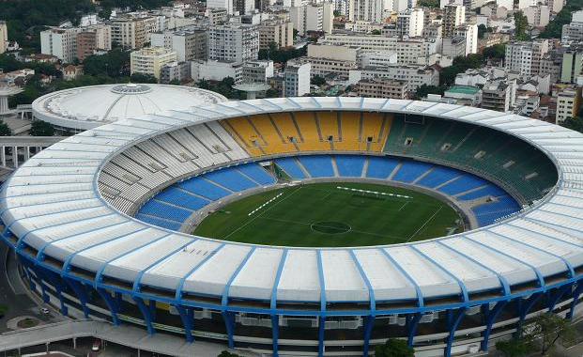
Maracana Stadium
Football fans may like to visit this famous football stadium. It was named after the Rio Marcana, a river in Rio de Janeiro and many famous footballers have played here.
Photo courtesy of Around the rings1992 (@flickr.com) - granted under creative commons licence - attribution

Slide 10
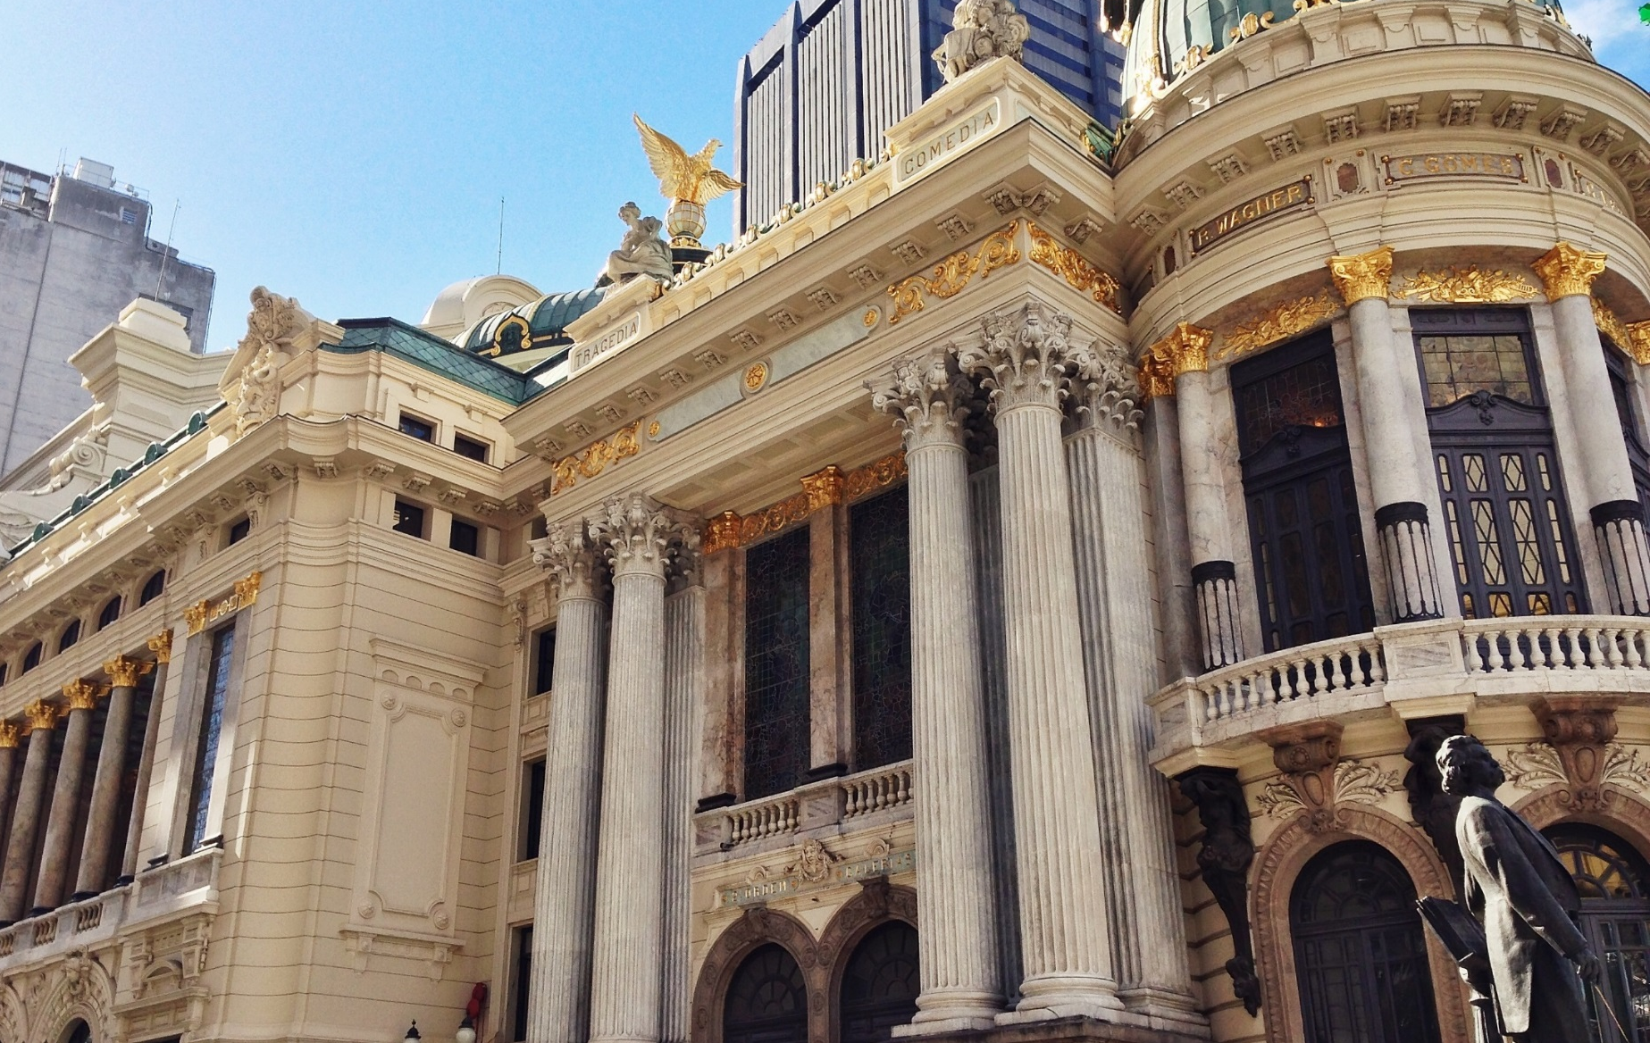
Theatro Municipal
The Theatro Municipal can be found in the city center of Rio de Janeiro. It was built in the beginning of the twentieth century and is thought to be one of the most beautiful and important theatres in the country.
Photo courtesy of giancornachin (@flickr.com) - granted under creative commons licence - attribution

Slide 11

Food
Feijoada is a traditional dish made with meat and black beans. It is usually served in Rio on Wednesdays and Saturdays.
A local favourite is feijao com arroz or beans and rice.
Tutu a Mineira is made with flour and bean paste and is served in all traditional Brazilian restaurants.
Polenta, couve and bisteca can all be found on the menu of local restaurants.
Salgadinhos usually consist of cheese bread, chicken croquettes, meat cakes, pasteis and empanadas.
Sweets include cuscuz branco, tapioca with sugar and coconut milk and pao de mel a honey cake covered in chocolate.

Slide 12
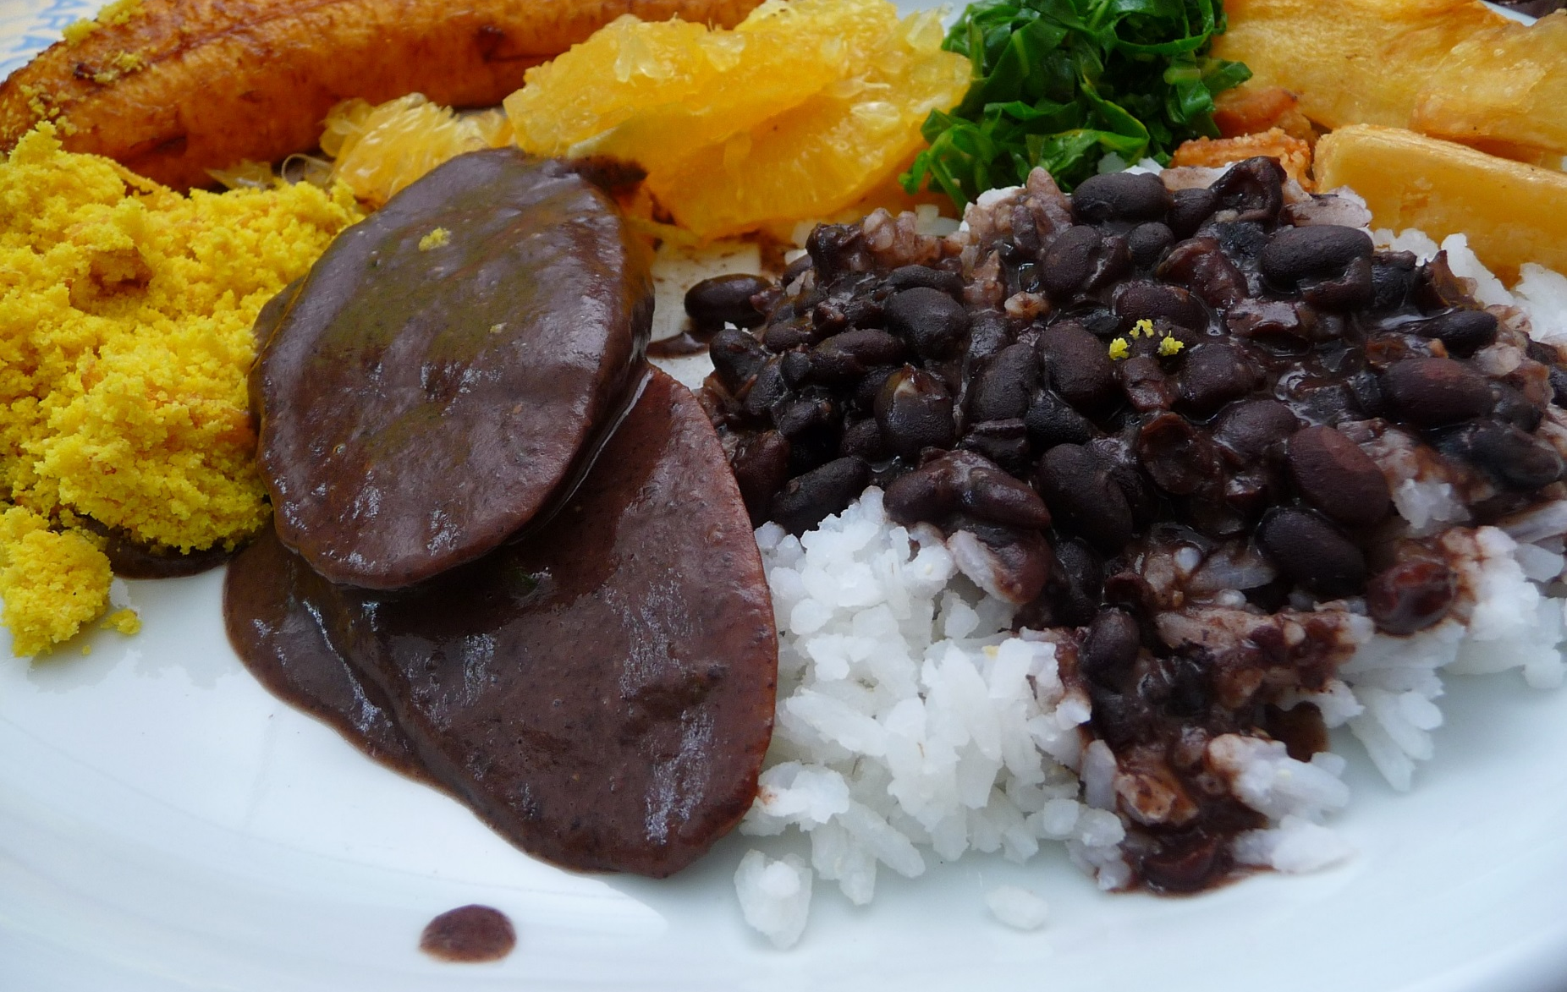
Feijoada
Photo courtesy of carlaarena (@flickr.com) - granted under creative commons licence - attribution

Slide 13
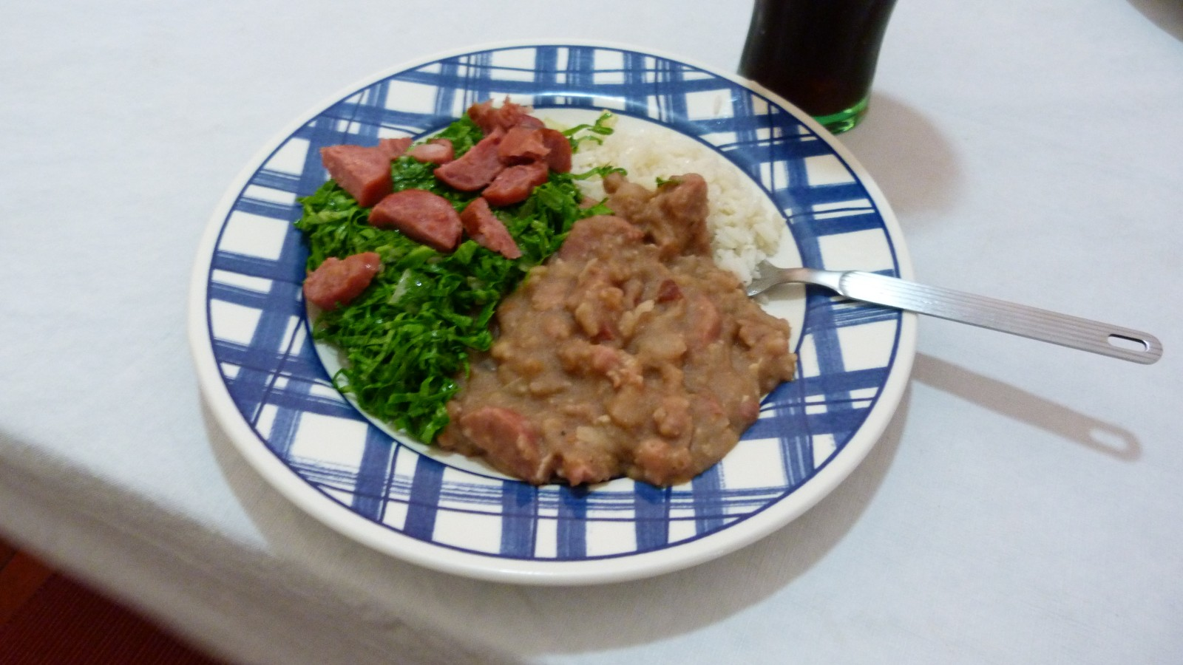
Tutu a Mineira
Photo courtesy of emerson.pardo (@flickr.com) - granted under creative commons licence - attribution

Slide 14
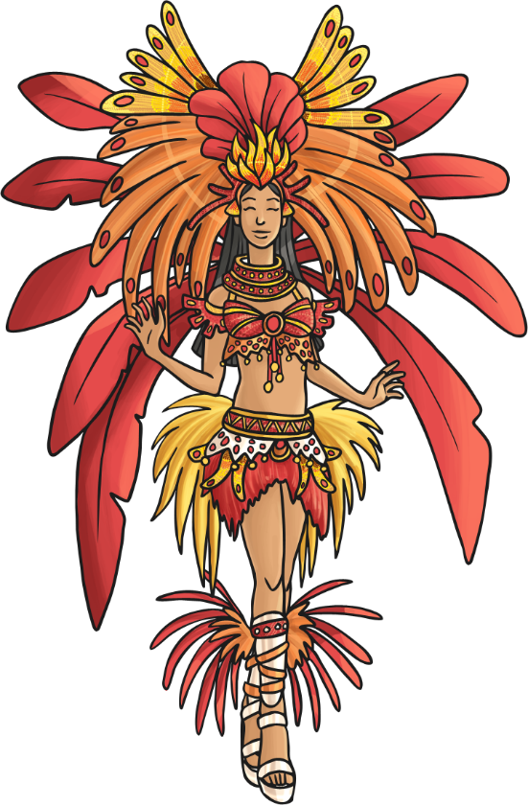
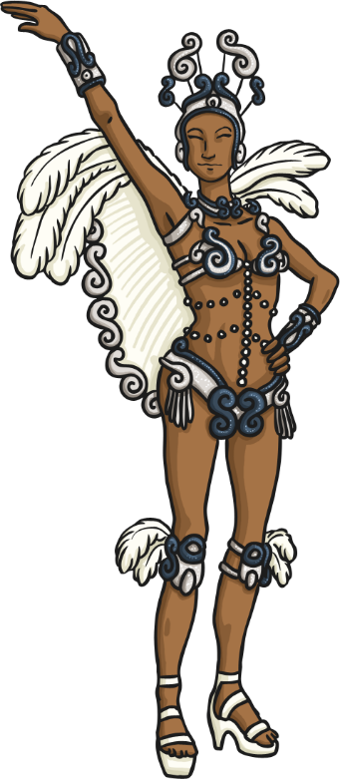
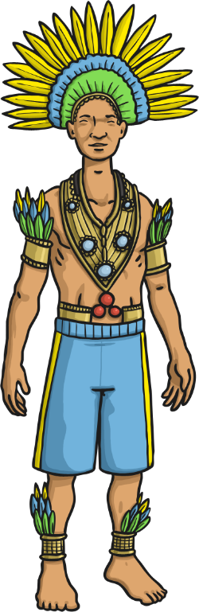
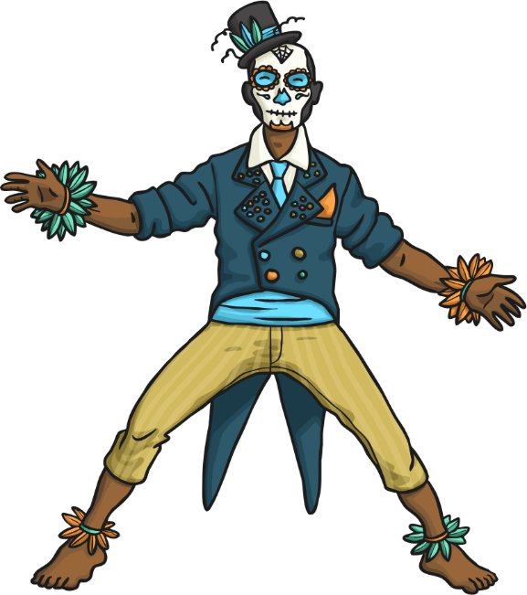
Carnival
Rio de Janeiro is famous for its carnival. Even though carnivals are celebrated all around the country, Rio is known as the capital of carnival. The carnival lasts for three days. During that time, Rio is filled with dancing, music, singing and lots of street parades showcasing colourful costumed dancers performing the samba.

