Slide 2
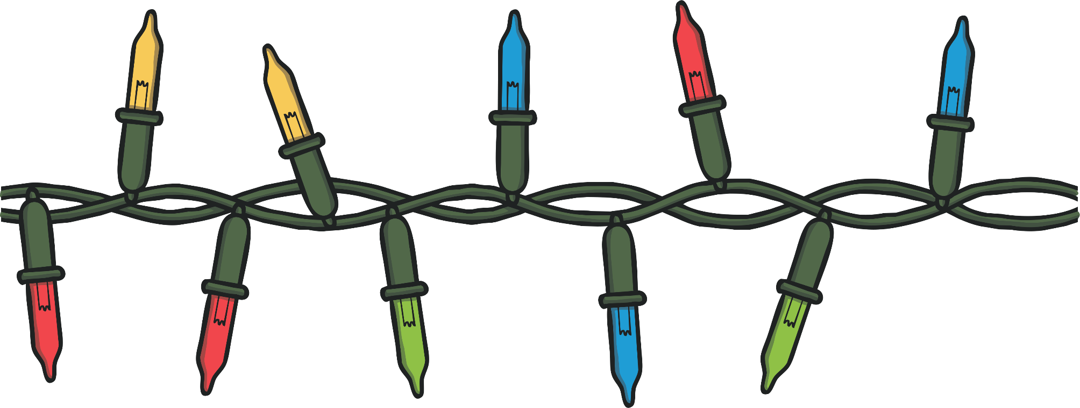
Lights
People put lights up outside their homes, similar to Christmas lights.

Slide 3
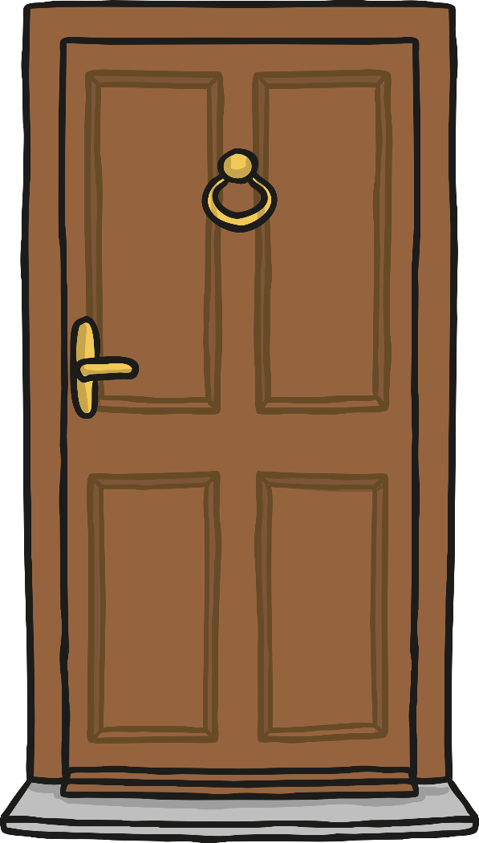
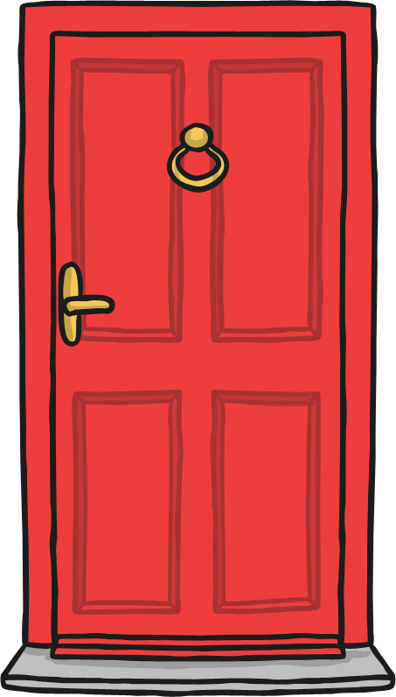
Doors and Windows
Doors and windows are painted red.

Slide 4

Decorations
Red and gold decorations are made from paper and hung on and around doors to bring good luck.

Slide 5


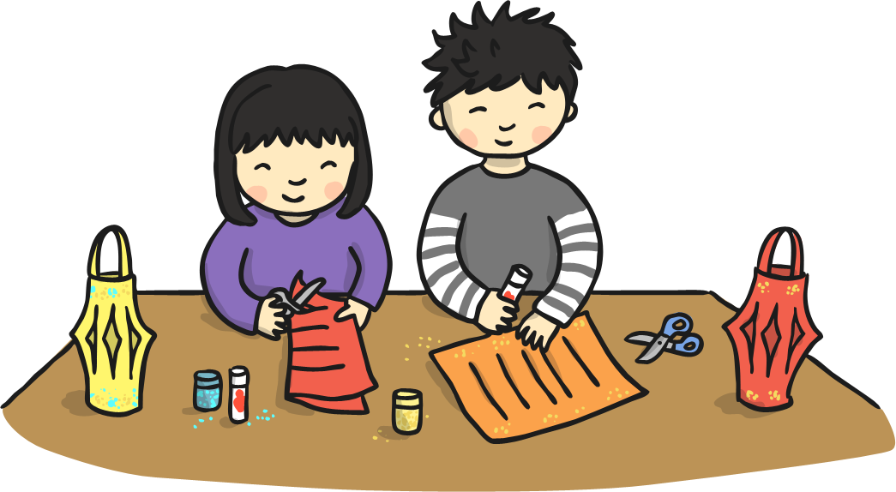
Lanterns
Homes are decorated with lanterns.

