Slide 1
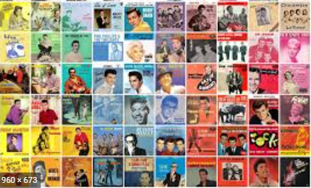
Music of the 1950s

Slide 2
Era of Change
In the 1950s a lot of change began to happen, especially in the USA.
The Civil Rights movement began. This was the struggle for
social justice. Black Americans marched and protested to gain equal rights under the law in the United States. This struggle still continues today.
Stereos that play records went on sale. People were able to
choose the music they wanted to play at home.
Colour televisions became available for purchase.People enjoyed watching music on TV.

Slide 3
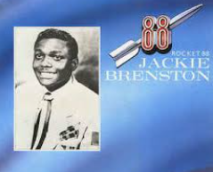
Birth of Rock and Roll
Rock ‘n’ Roll was developed in the USA in the 1950s. It grew from rhythm and blues, jazz and swing music. It was also influenced by gospel, country and folk music.
Jackie Brenston and the Delta Cats' 'Rocket 88' is considered to be the first Rock 'n' Roll song https://www.youtube.com/watch?v=eAwUesMFM1E

Slide 4
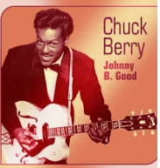
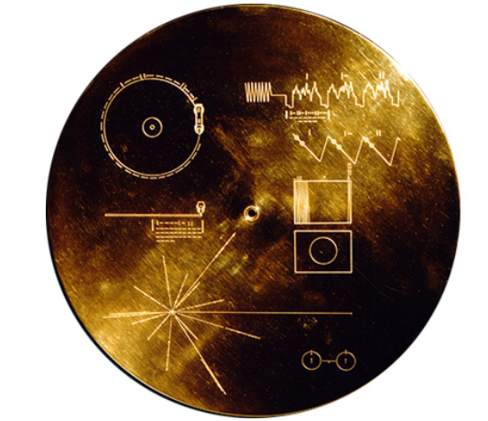
Chuck Berry
Chuck Berry is considered an inventor of Rock ‘n’ Roll. He had a strong influence on how it developed. When NASA sent a ‘Golden Record’ to Space in 1977, as a form of time capsule, they included this song on it. https://voyager.jpl.nasa.gov/golden-record/
https://www.youtube.com/watch?v=6ROwVrF0Ceg

Slide 5
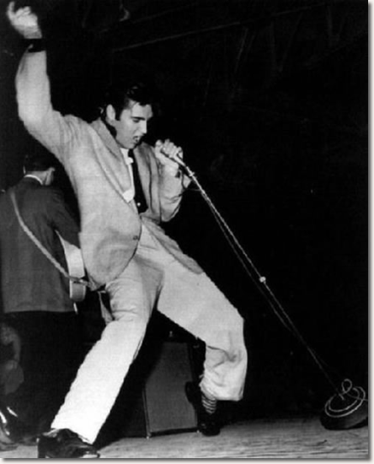
Elvis Presley
He was nicknamed the King of Rock and Roll.
His career began when Sam Phillips discovered
him recording songs for his mother’s birthday.
Elvis performed at the Grand Ole Opry. This is the most famous country-music stage in Nashville, Tennessee.
Presley was criticized and got into trouble for his dancing on television. At this time, a lot of people thought that this dancing was vulgar and inappropriate. https://www.youtube.com/watch?v=sGZm7EOamWk

Slide 6
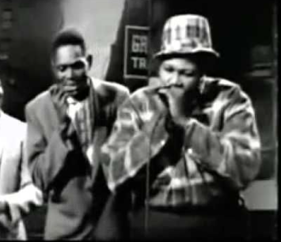
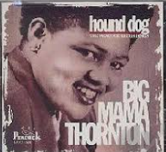
Women and Rock ‘n’ Roll
Female musicians often had a strong influence on the development of Rock ‘n’ Roll, but they didn’t enjoy the same success and fame as men in the 1950s.
Big Mama Thornton, whose real name was Willie Mae Thornton, first recorded Hound Dog in 1952.
https://www.youtube.com/watch?v=frsBq9MCNVg

Slide 7
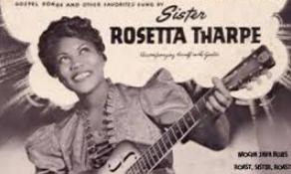
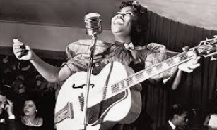
Sister Rosetta Tharpe
During the 1940s, 50s and 60s, Sister Rosetta Tharpe played a significant role in the creation of rock & roll. She inspired musicians like Elvis Presley, Jerry Lee Lewis, Johnny Cash, Little Richard and Chuck Berry.
Her style of guitar playing is known as distorted guitar.
She is called the Godmother of Rock ‘n’ Roll.
https://www.youtube.com/watch?v=-ZKjwYB2pN0
https://www.youtube.com/watch?v=-88l-M0KgkI

