Slide 1
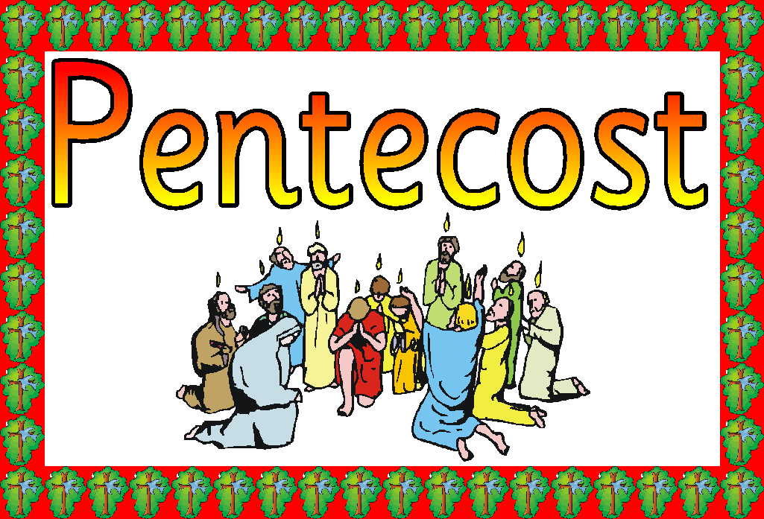

Slide 2
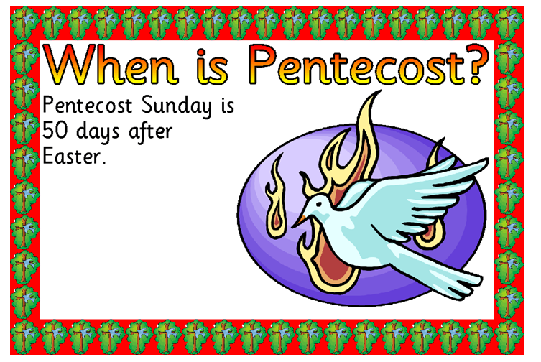

Slide 3
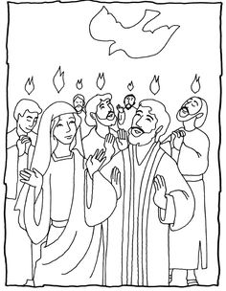
Pentecost explained
Pentecost, is when the Holy Spirit descended (came down) on the Apostles and Mary.
The Apostles were lonely and frightened without Jesus. So Jesus sent the Holy Spirit to comfort them and give them courage.
The church is usually decorated in red and white at this time.(The banners, priests vestibules and the flowers)
Red is the colour of flames and white is the colour of goodness.

Slide 4
The Story of Pentecost
Now that Jesus was dead, the apostles were scared. They were unsure and they had no-one to lead them or to tell them what to do.
Jesus had left them a task to do, but they couldn’t do it while they were scared. So Jesus sent the Holy Spirit to them on Pentecost Day, a Jewish feast. Many Jews had gathered in the town where the apostles were staying.
The Holy Spirit came in the shape of tongues of fire and of a great wind. The wind filled the house and the tongues of fire rested above the apostles’ heads.

Slide 5
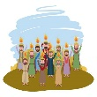
When the apostles turned to speak to each other, they found to their amazement that they could speak in many different languages. Soon a crowd had gathered outside the house where the apostles were. Each person was surprised that his own language was being spoken.
The apostles were different men now. No longer were they frightened or bewildered. God had given the gift of his Holy Spirit to the apostles which made them more like Christ so that they could respond with unselfish love to the love which God the Father had given them through Jesus.

Slide 6

Bible
This story of Pentecost was read at mass this weekend. If you have a Bible at home, you can find the story. It is in the New Testament, in a book called the Acts of the Apostles.
The reference is: Acts 2:1-13.

