Slide 1
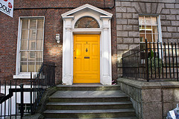
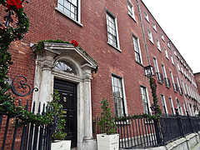
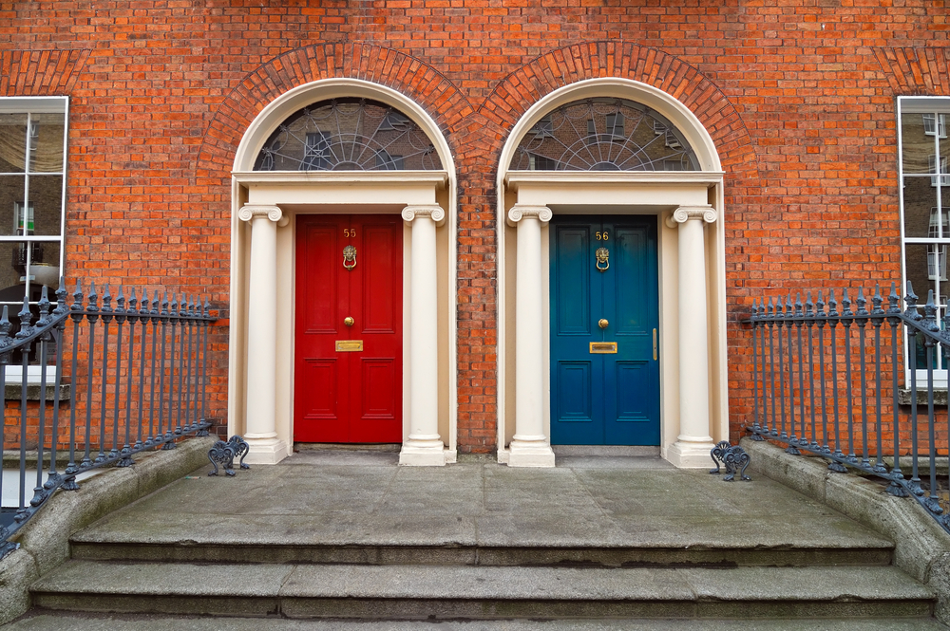
Georgian Dublin
"Georgian Dublin" a style of architecture associated with time that four King Georges ruled between 1714 and 1830.

Slide 2
Facts
Jonathan Swift, Oliver Goldsmith, Sheridan Le Fanu and Wolfe Tone were famous people associated with this time.
People used their wealth to re-invent the city using the latest ideas and most fashionable trends.
Dublin changed from a grubby old medieval city into a clean city with broad streets and large green squares surrounded by rows of uniformly impressive brick houses.

Slide 3
Facts
Georgian Dublin houses were build during a golden period for Dublin.
The city was prospering ( growing successfully) from the trade wealth being created by the newly dominant British Empire
Dublin was to become the fifth biggest city in Europe
It was commonly said that Dublin was the "second city" of the British Empire, next to London.

Slide 4
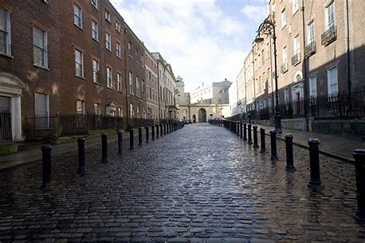
At the start of the Georgian period, the Northside of Dublin was considered to be far more fashionable.
Parnell Square, known as Rutland Square at the time, at the top of O'Connell Street, known as Sackville Street at the time, was popular but not as prestigious as Mountjoy Square.
Henrietta Street - a wide cobble-stoned street, lined with grand examples of Georgian homes, that leads up to James Gandon's King's Inn.
Throughout the 18th century, these places were very modern and exciting places to live.
There would have been a great atmosphere with the comings and goings of
the Irish elite - the Lords, Ladies, bishops, judge
each household's team of servants
of course, the many tradesmen, shopkeepers.

Slide 5
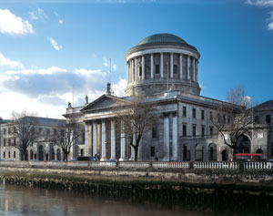
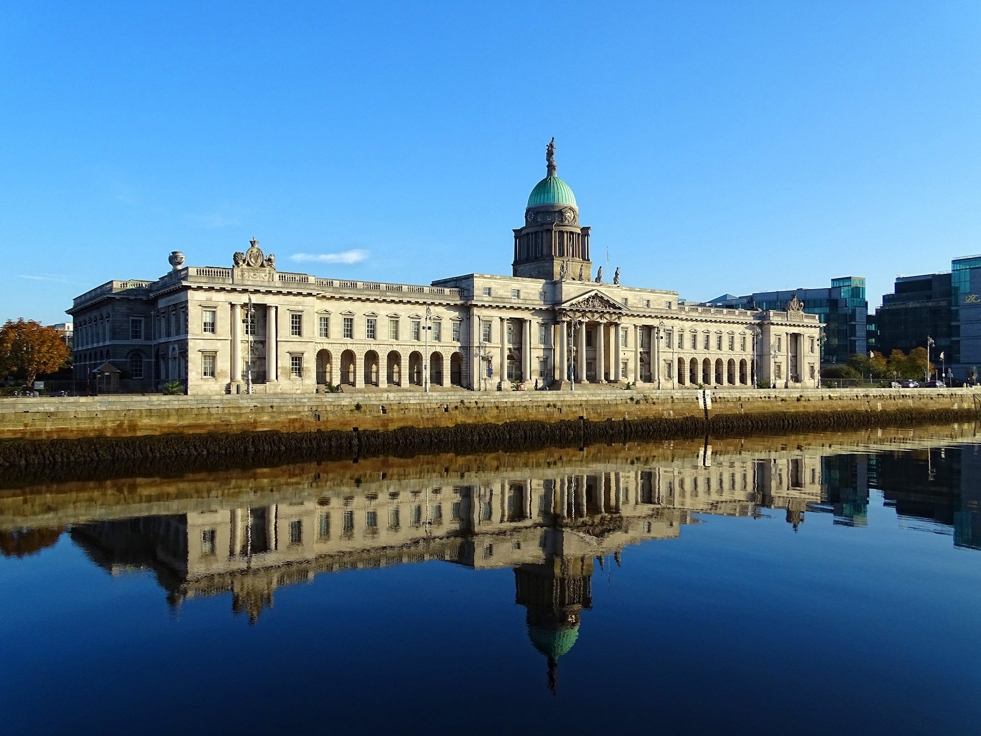
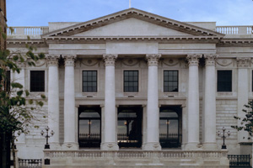
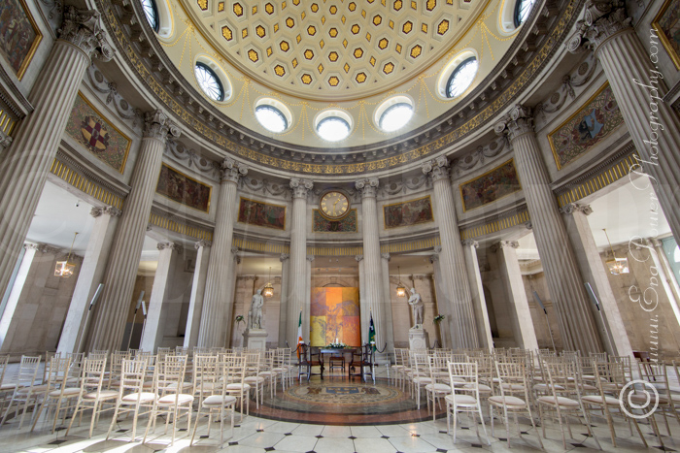
The most famous architect of this period in Dublin's history was James Gandon. He designed; The Four Courts, Dublin City Hall, King's Inn and The Custom House.

Slide 6
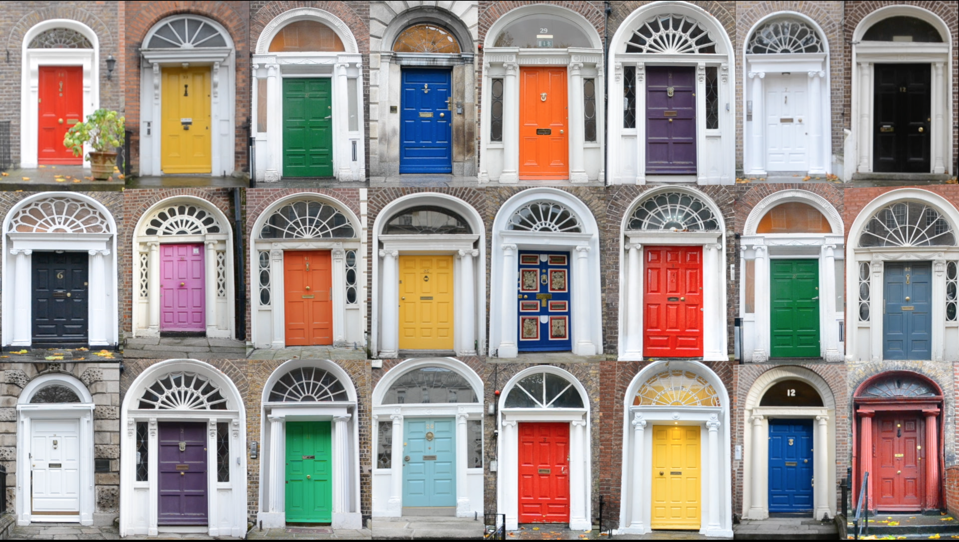
The buildings have very distinctive doorways

Slide 7
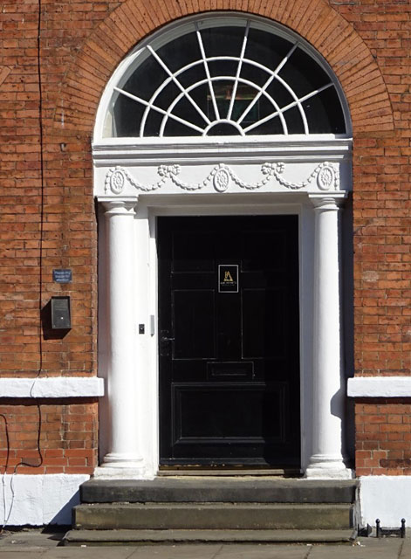
Georgian Fanlights
Fanlights are a semi-circular windows that look like open fans.
They let light shine into the hallway.
Have you seen a fanlight? Or do you have one in your house?

Slide 8
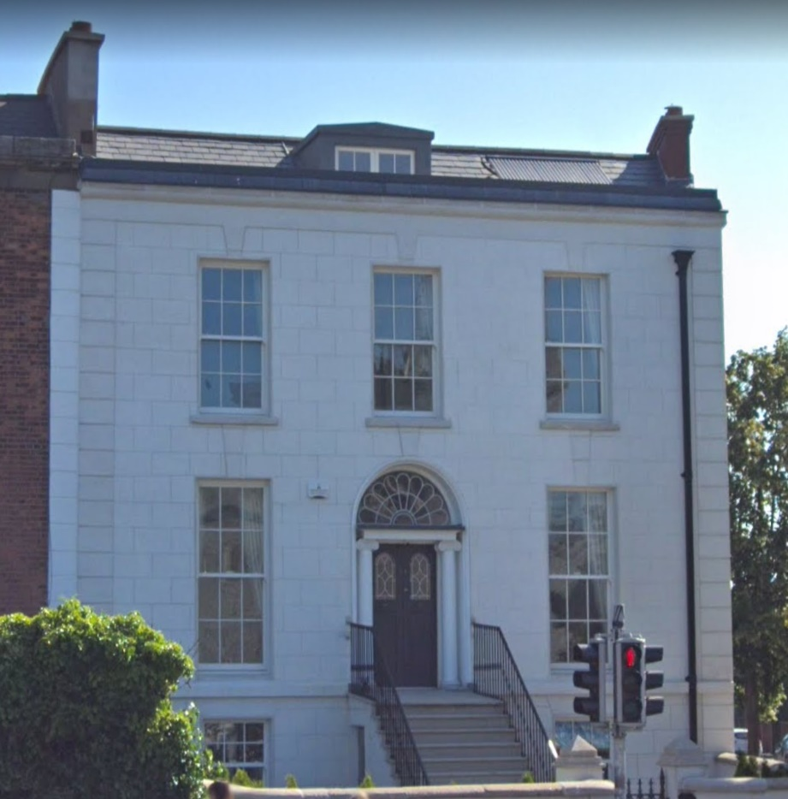
Different floors
Basements are often visible from street level and protected by iron railings. These were used for servants’ quarters and kitchens.
The main living area was on the first floor level or “piano nobile.”
The top floor was very often reserved for staff; this is why the windows on the first and second floors are regularly larger than those at the top.

Slide 9
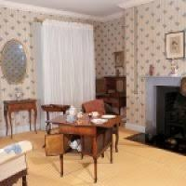
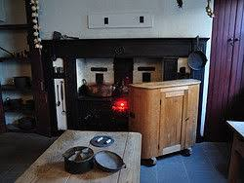
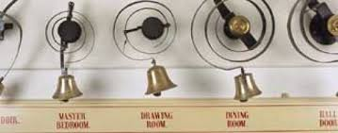
Tour of a Georgian House
Click on the link below to have a virtual tour of No. 29 Fitzwilliam Square https://www.youtube.com/watch?v=H0GP0FdhrNI
PLEASE ASK FOR PARENT PERMISSION BEFORE CLICKING ON ANY LINKS

Slide 10
The End of an Era
Sadly, Dublin's Golden Age came to an end when the London government decided to change the way they ruled. They withdrew Dublin’s ability to have it’s own parliament ( This was known as Home Rule)
The Act of Union came into effect on the first day of 1801 and this transferred the power to London so therefore Dublin lost it’s prestige and importance.
Many ambitious families moved across the Irish sea, leaving a lot of servants and tradesmen unemployed.

Slide 11
Here are two videos you may find interesting
Tour of Georgian Dublin https://www.youtube.com/watch?v=LtPDSPxDkI8
Georgian Dublin and Newman House
https://www.youtube.com/watch?v=Y_wDXd3DtYk
PLEASE ASK FOR PARENT PERMISSION BEFORE CLICKING ON ANY LINKS

Slide 12
Activities
Write 5 facts you learned from the power point into your own words in your SESE copy.
Write 5 facts you learned from the videos in your own words in your SESE copy.
Tell me any other facts you know about Georgian Dublin.
Draw a Georgian Door- with the panels and fanlight.
Draw a Georgian House- with the floors and different sized windows.
*You do not have to do all of these

