Slide 1
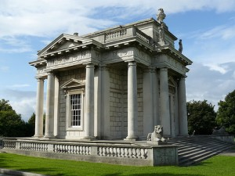
Casino Marino

Slide 2
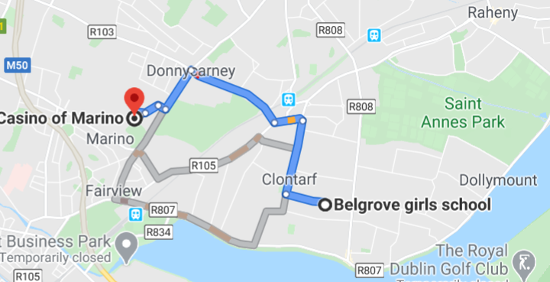
Location

Slide 3
Casino Marino
The Casino was designed by Sir William Chambers in the late eighteenth-century as a pleasure house for James Caulfeild, 1st Earl of Charlemont.
Casino is the Italian word for small house
It a very important example of Georgian architecture at in Ireland.
This video gives a brief history:
https://www.youtube.com/watch?v=ZmsuwbA0tNU#action=share

Slide 4

Architecture
The massive columns are hollow and serve as gutters and the decorative urns on the roof are actually chimneypots.
From the outside it looks like a small garden pavilion, inside there are actually16 rooms on three floors.
There are:
Kitchens
servants quarters
a library
several reception rooms
bedrooms
tunnel to the main house where food and drink was transported for parties

Slide 5
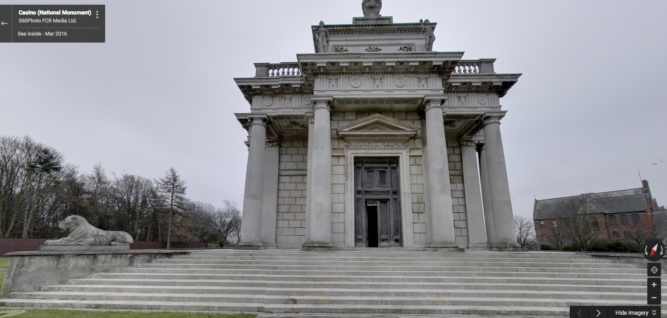
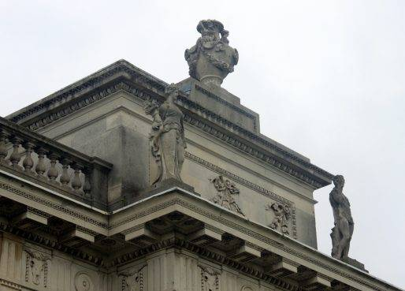
Casino Tour
Here is a link to the online tour seeing as we can not visit it at the moment: http://casinomarino.ie/online-tour/

