Slide 1


Slide 2

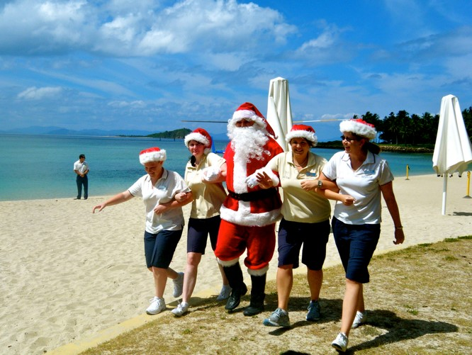
Australia
The temperature in Australia on Christmas day is usually 86-122°F.
Because it is so hot, traditional dinners have been replaced with family gatherings in back yards and picnics in parks, gardens and on the beach.
A typical Christmas menu could include seafood, glazed ham, cold chicken, duck or turkey, cold deli meats, pasta, salads, desserts of all types, fruit salad, ice-cream plus Christmas treats such as mince pies.
Although it is so hot, Australian people still have Christmas trees and lights, go carol singing and send Christmas cards just like us.
Photo courtesy of Sarah_Ackerman (@flickr.com) - granted under creative commons license - attribution

Slide 3
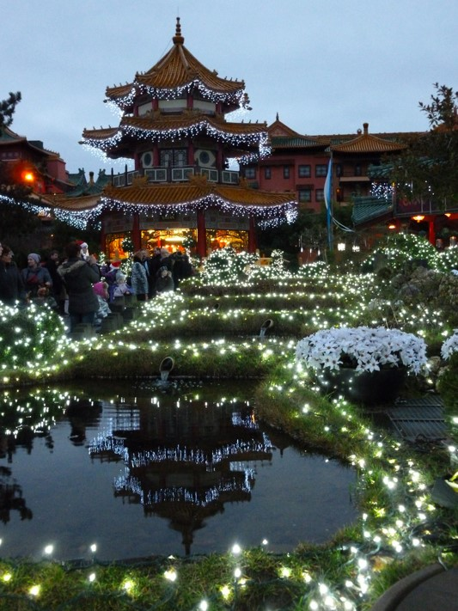
China
Christians in China celebrate by lighting their houses with paper lanterns.
Christmas trees are called ‘trees of light’ and are decorated with paper chains, paper flowers and paper lanterns.
Lots of people in China do not celebrate Christmas. The main winter festival is called Chinese New Year which takes place in January. Chinese people worship their ancestors during Chinese New Year.
Photo courtesy of rachel_titiriga (@flickr.com) - granted under creative commons licence - attribution

Slide 4
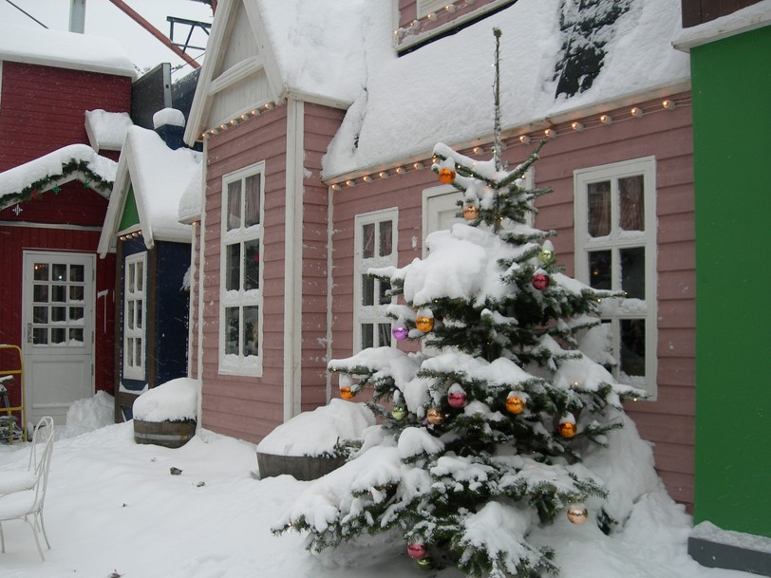
Denmark
The Christmas feast in Denmark is celebrated at midnight on
Christmas Eve.
They have a special rice pudding dessert in which a single almond is hidden. Whoever finds the almond will have good luck for a whole year.
Instead of Santa Claus they have a bringer of gifts named Julemanden.
Julemanden arrives in a sleigh drawn by reindeer and a sack over his back.
Julemanden has lots of elf helpers named Juul Nisse who are said to live in attics.
Photo courtesy of michaeljohnbutton (@flickr.com) - granted under creative commons licence - attribution

Slide 5
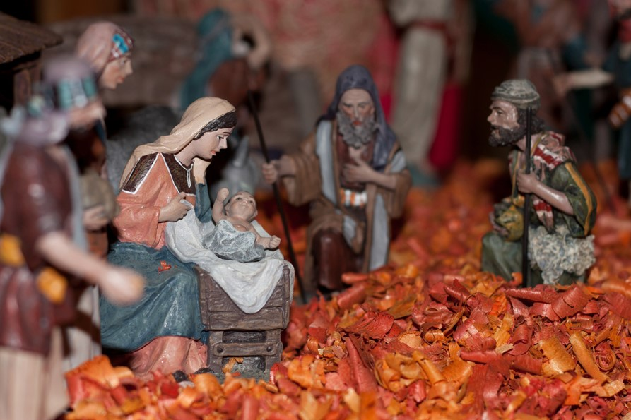
France
Most French homes at Christmas time have nativity displays with clay figures called santons. Craftsmen make the santons all throughout the year to sell at annual Christmas fairs.
Most French households like both a nativity scene or a festive wreath as well as a Christmas tree.
The French make a traditional log shaped cake called a bûche de Noël (Christmas log).
Photo courtesy of Eusebius@commons (@flickr.com) - granted under creative commons licence - attribution

Slide 6
France
Christmas dinner varies in different parts of France. Some favorites are goose, turkey and oysters.
French children receive gifts from Père Noël who travels with his stern friend Père Fouettard who reminds Père Noël how each child has behaved in the past year.
Photo courtesy of Eusebius@commons (@flickr.com) - granted under creative commons licence - attribution

Slide 7
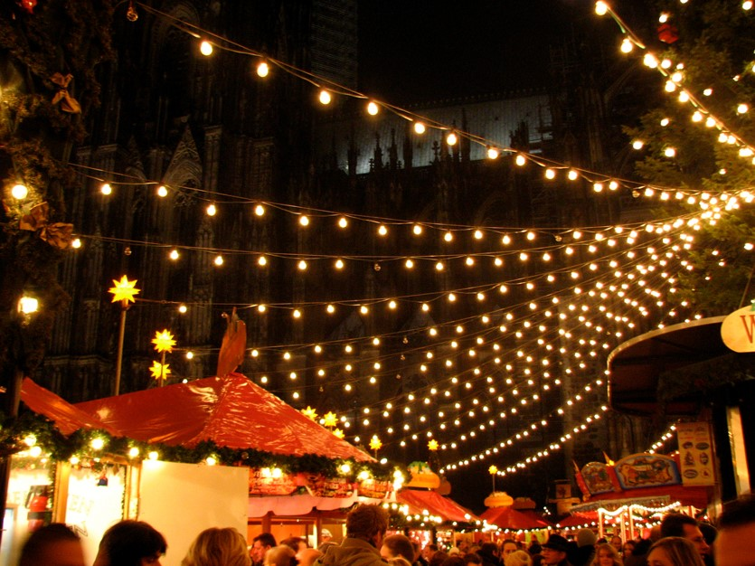
Germany
According to legend, on Christmas Eve in Germany rivers turn to wine, animals speak to each other, tree blossoms bear fruit, mountains open up to reveal precious gems and church bells can be heard ringing in the bottom of the sea. Only the pure of heart can witness the Christmas magic.
While children are distracted the Christmas tree is brought out and decorated on Christmas Eve. The presents are put underneath. Plates are laid out for each member of the family with fruit, nuts, chocolate and cookies. Carols are then sung, sparklers are lit, the Christmas story is read and then the gifts are opened.
Photo courtesy of CGP Grey (@flickr.com) - granted under creative commons licence - attribution

Slide 8
Germany
On Christmas day there is a banquet of roast goose, breads and marzipan.
There are lots of huge Christmas fairs in Germany which are very beautiful.
After the presentation of the tree there is a huge feast of dishes like suckling pig, white sausage, macaroni salad and many more.
Photo courtesy of CGP Grey (@flickr.com) - granted under creative commons licence - attribution

Slide 9
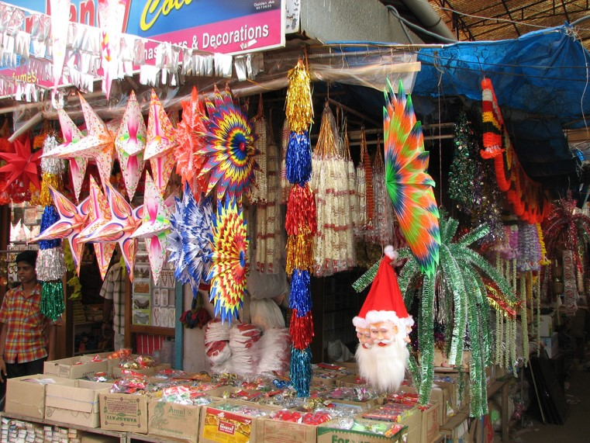
India
Christians in India decorate mango and banana trees at Christmas time.
Decorations are colorful and bright.
In some parts of India, small clay oil-burning lamps are used as Christmas decorations. They are placed on the edges of roofs and on the tops of walls.
Churches are lit with poinsettias (red Christmas flowers) and candles for the Christmas Evening service.
Photo courtesy of mckaysavage (@flickr.com) - granted under creative commons licence - attribution

Slide 10
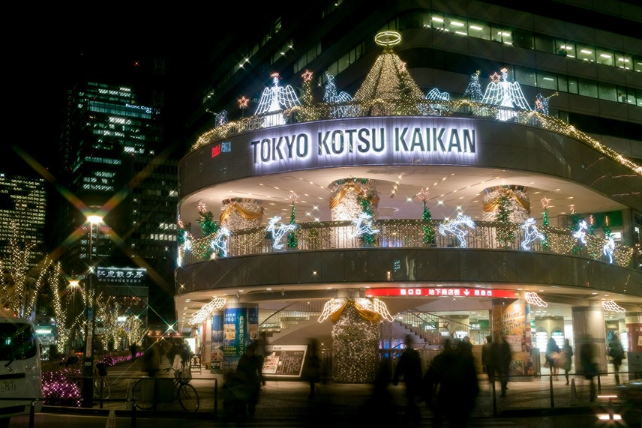
Japan
Christmas was introduced to Japan by the Christian missionaries and for many years only those who were of Christian faith celebrated it.
Today, lots of people in Japan love the Christmas season and it’s almost universally celebrated even though only 1% of people believe in Christ.
The idea of exchanging gifts appeals to Japanese people.
Shops in Japan have wonderful displays and decorations to advertise gifts to buy.
Photo courtesy of t-mizo (@flickr.com) - granted under creative commons licence - attribution

Slide 11
Japan
Besides exchanging gifts, Japanese people eat turkey on Christmas day, have Christmas trees and decorate their houses with evergreens and mistletoe.
A Buddhist monk named Hotei-osho acts like Santa Claus. He brings presents to each house for children. Some think he has eyes in the back of his head so that children behave when he is nearby.
Photo courtesy of t-mizo (@flickr.com) - granted under creative commons licence - attribution

Slide 12
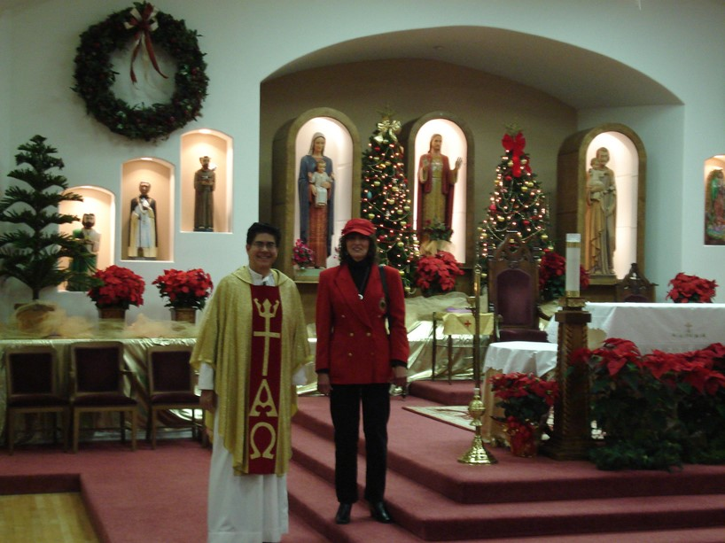
Mexico
Several weeks before Christmas there are huge markets set up in towns and cities in Mexico which offer crafts, food and flowers for the Christmas season. Some people travel for days to get to these markets.
The poinsettia is a red flower native to Mexico that is used widely in Mexico as a Christmas decoration. It has been connected with Christmas since the 17th century.
Photo courtesy of sburke2478 (@flickr.com) - granted under creative commons licence - attribution

Slide 13
Mexico
The main Christmas celebration in Mexico is called Las Posadas. People re-enact Joseph and Mary’s search for somewhere to stay in Bethlehem. They go house to house getting refused until they finally reach a house where an altar and nativity scene have been set up.
Once they have reached the right house a traditional prayer is spoken and the party begins. Food and drink are served and then children take it in turns to break open the piñata.
Photo courtesy of sburke2478 (@flickr.com) - granted under creative commons licence - attribution

Slide 14
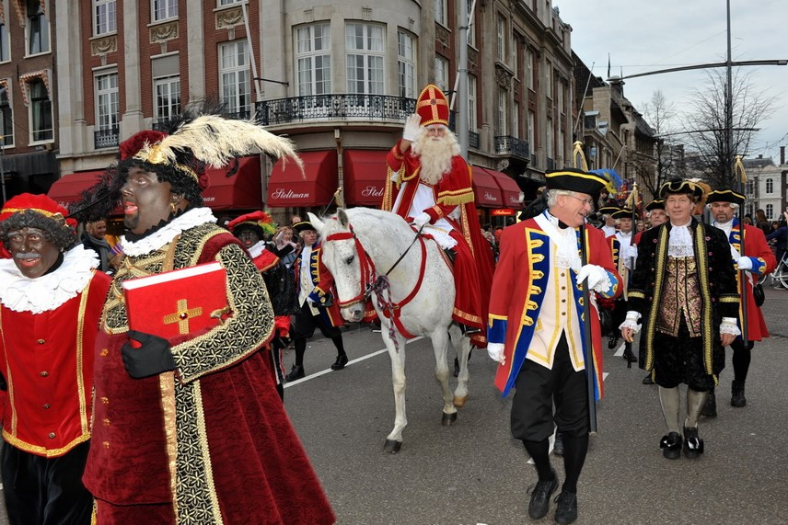
Netherlands
In the Netherlands Santa Claus is known as Sinterklaas.
Sinterklaas sails from Spain on his feast day, December the 5th.
Children fill their shoes with hay and sugar for Sinterklaas’s horse and awake to find them filled with nuts and candy.
Photo courtesy of FaceMePLS (@flickr.com) - granted under creative commons licence - attribution

Slide 15
Netherlands
Sinterklaas appears in person in children's homes asking the children about their behavior in the past year.
The people of Twente in east Holland hold a special Christmas ceremony where special horns are blown to chase away evil spirits and to announce the birth of Christ.
Photo courtesy of FaceMePLS (@flickr.com) - granted under creative commons licence - attribution

Slide 16

Merry Christmas
Sheng Dan Kuai Le
Feliz Navidad
Fröhliche Weihnachten
Joyeux Noel
Vrolijk Kerstfeest
Pozdrevlyayu s prazdnikom Rozhdestva is Novim Godom
Shinnen omedeto

Slide 17
